Slide 1
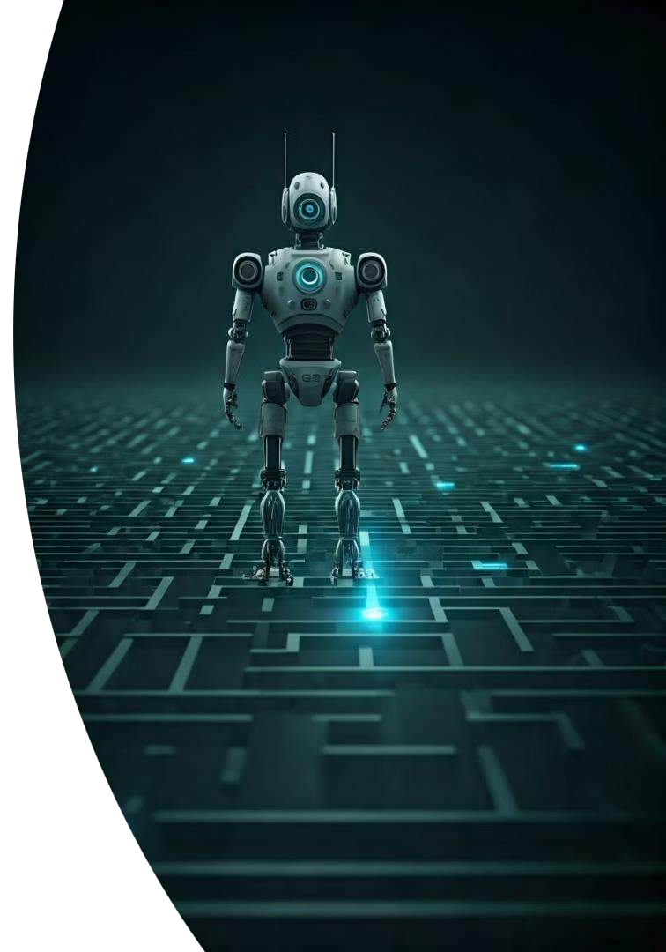
Project Members
Gouda, Ahmed
Ayan, Ali
Umer, Ahmed Baig Urwa, Mughal

Slide 2
TriNav
Tri-Layer Navigation (A*, DWA, MPC)
This presentation explores a hierarchical navigation system for differential-drive Unmanned Ground Vehicles (UGVs) that combines global path planning with reactive and predictive local control. Our approach integrates A* algorithm, Dynamic Window Approach (DWA), Model Predictive Control (MPC), and PID control to enable safe, smooth, and efficient navigation in cluttered environments.

Slide 3
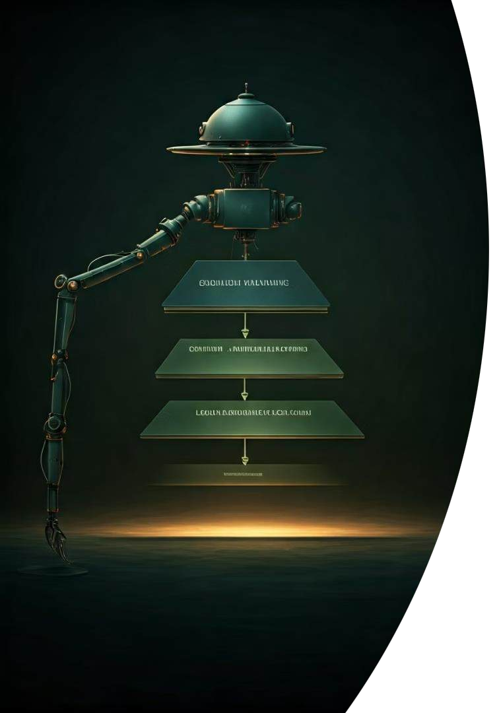




Introduction and Motivation
Main Goal
Design and implement a robust, real-time hierarchical navigation system for a differential- drive UGV that ensures safe, smooth, and efficient path execution in static cluttered environments.
Challenges
Non-holonomic constraints in differential-drive systems challenge traditional control methods, requiring a layered approach that balances completeness, safety, optimality, and hardware feasibility.
Approach
Combining DWA and MPC leverages DWA's fast local collision handling and MPC's optimization capabilities, aligning with hybrid designs demonstrated in state-of-the-art literature.

Slide 4
Problem Statement
Core Challenge
How can a differential-drive UGV autonomously and reliably navigate from start to goal in a cluttered static environment using a modular architecture that combines global planning, local reactive behavior, and control optimization under real-time constraints?
Recent literature highlights limitations in individual approaches: global planners lack adaptability, local planners can get trapped in local minima, and MPC is computationally intensive.
Proposed Solution
A hybrid navigation stack consisting of:
A* for global path planning using an obstacle-based grid map
DWA for short-term collision-aware trajectory prediction
MPC to refine local trajectories by optimizing smoothness
PID control to accurately execute velocity commands
This layered strategy enables efficient planning, local adaptation, dynamic optimization, and stable execution.

Slide 5



Dynamic Modeling
Non-holonomic Kinematics
Discretized with first-order filters where τv=0.2 and τω=0.1
DWA Trajectory Prediction
Predicts short trajectories for each candidate command (v, ω)
Key Challenges
Nonlinear kinematics, balancing goal-reaching with obstacle avoidance
The system uses a base continuous model that is discretized to balance model fidelity and computational simplicity. This approach unifies local planning and execution kinematics, enabling direct cost computation on predicted states while maintaining real-time performance.

Slide 6
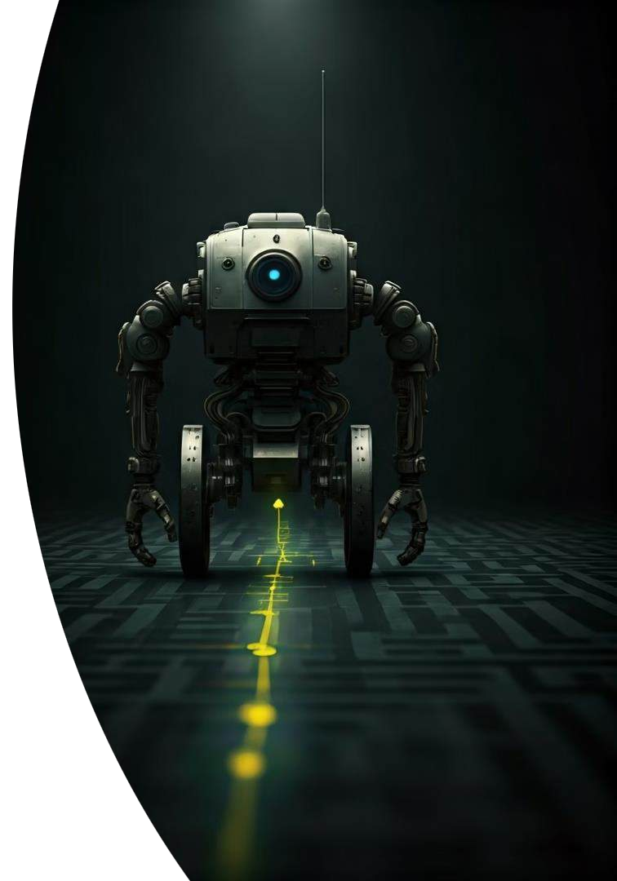

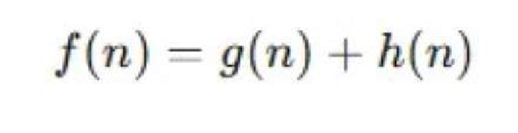

Path and Trajectory Planning
A* Global Planner
Creates a 2D occupancy grid from obstacles and performs A* search using Euclidean heuristic. Path simplification improves trajectory smoothness.
Dynamic Window Approach (DWA)
Defines a dynamic window of admissible velocities based on current state and acceleration limits, simulating reachable velocities over a short time horizon.

Slide 7



Path and Trajectory Planning
Trajectory Refinement (MPC)
Solves over a two-step horizon using the discrete kinematic model, optimizing for goal proximity, heading alignment, and obstacle avoidance.
Dynamic Model
The differential drive robot follows a non-holonomic constraint, meaning it cannot move sideways. Its continuous motion model is defined as:

Slide 8
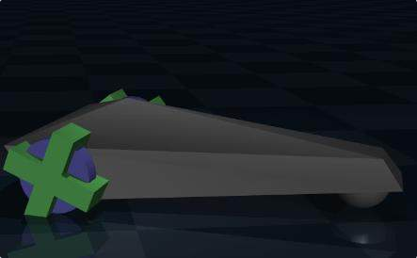
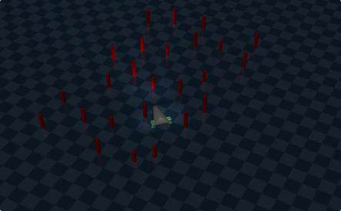
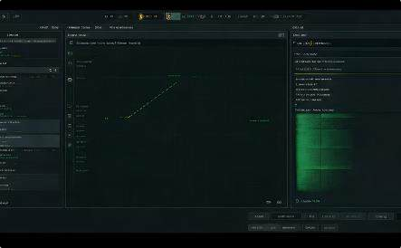
Simulation Environment and Setup
Differential Drive UGV
The simulation uses a differential drive robot model with non-holonomic constraints, mimicking real-world limitations in steering and movement. This configuration is common in small to mid-scale robots used for indoor navigation and logistics.
Test Environment
A cluttered static environment with various obstacles creates a challenging navigation scenario. The maze-like setup tests the robot's ability to find efficient paths while avoiding collisions and maintaining smooth motion profiles.
Simulation Tools
The simulation framework provides visualization of robot states, planned paths, and control signals. This allows for comprehensive analysis of the navigation system's performance across different scenarios and configurations.

Slide 9
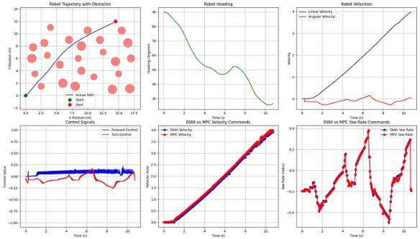
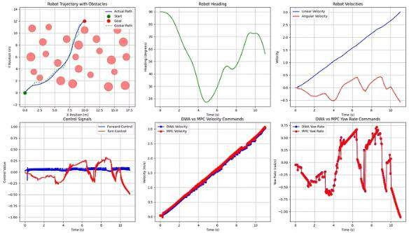
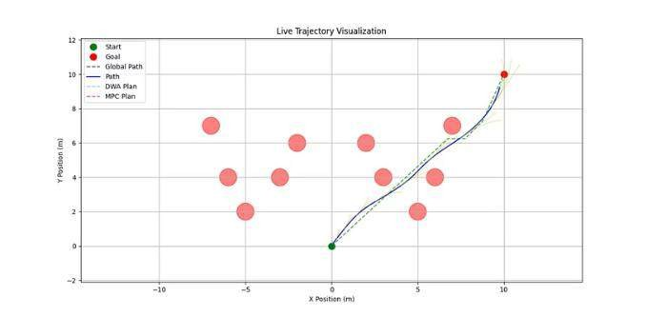
Results and Analysis
Our results demonstrate successful navigation from start to goal with smooth, collision-free paths. The velocity profiles show stable linear velocity (0-0.6 m/s) and appropriate angular velocity adjustments (±1 rad/s) for obstacle maneuvers. Comparing algorithms, MPC consistently produces smoother trajectories and control signals than the more reactive DWA, particularly when guided by a global path.

Slide 10
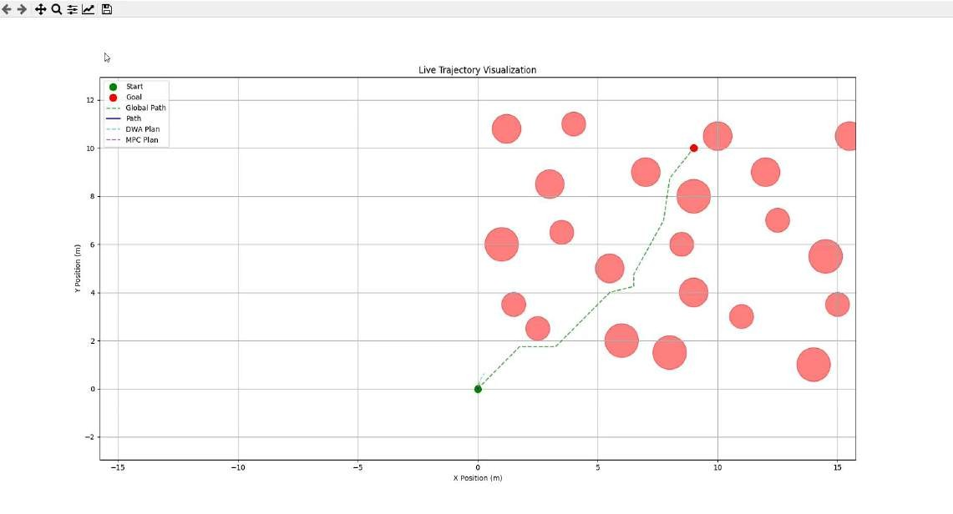
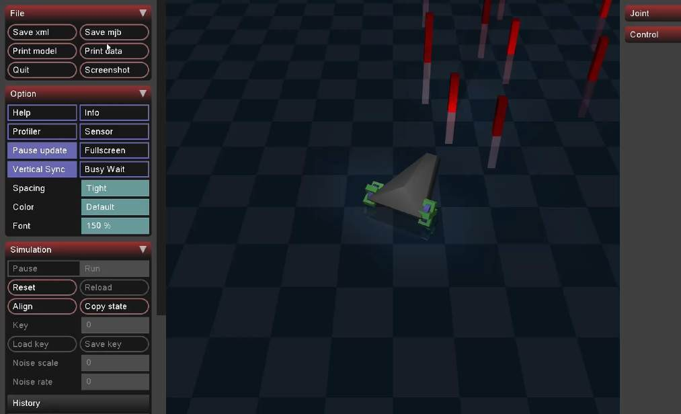
Simulation

Slide 11

Research Contributions and Limitations
Key Contributions
Limitations
Future Work
Hybrid planner-controller architecture ensuring global feasibility, reactive safety, and trajectory optimization
Improved robustness by integrating MPC to refine reactive DWA commands
Validation through consistent goal- reaching with smooth, collision-free paths
Static environment only - assumes fixed obstacles
Short MPC horizon limits long-term
foresight
Wheel slip and measurement drift are unmodeled
Integrate sensor-based dynamic replanning
Extend MPC horizon with faster solvers
Add Control Barrier Functions for formal safety
Implement state estimation to manage odometric errors

Slide 12








Conclusion
Superior Navigation Performance
Validated through experiments
Effective Integration
A*, DWA, MPC, and PID working together
Smoother Trajectories
MPC consistently outperforms DWA alone
Real-time Robotic Navigation
Proven hierarchical architecture
Our experiments validate that combining global planning (A*) with local planning (DWA) and motion optimization (MPC), executed via PID control, results in superior navigation performance for differential drive robots. The best performance is observed when all modules are integrated, confirming the effectiveness of our hierarchical planning and control architecture for real-time navigation in complex environments.

